Slide 1

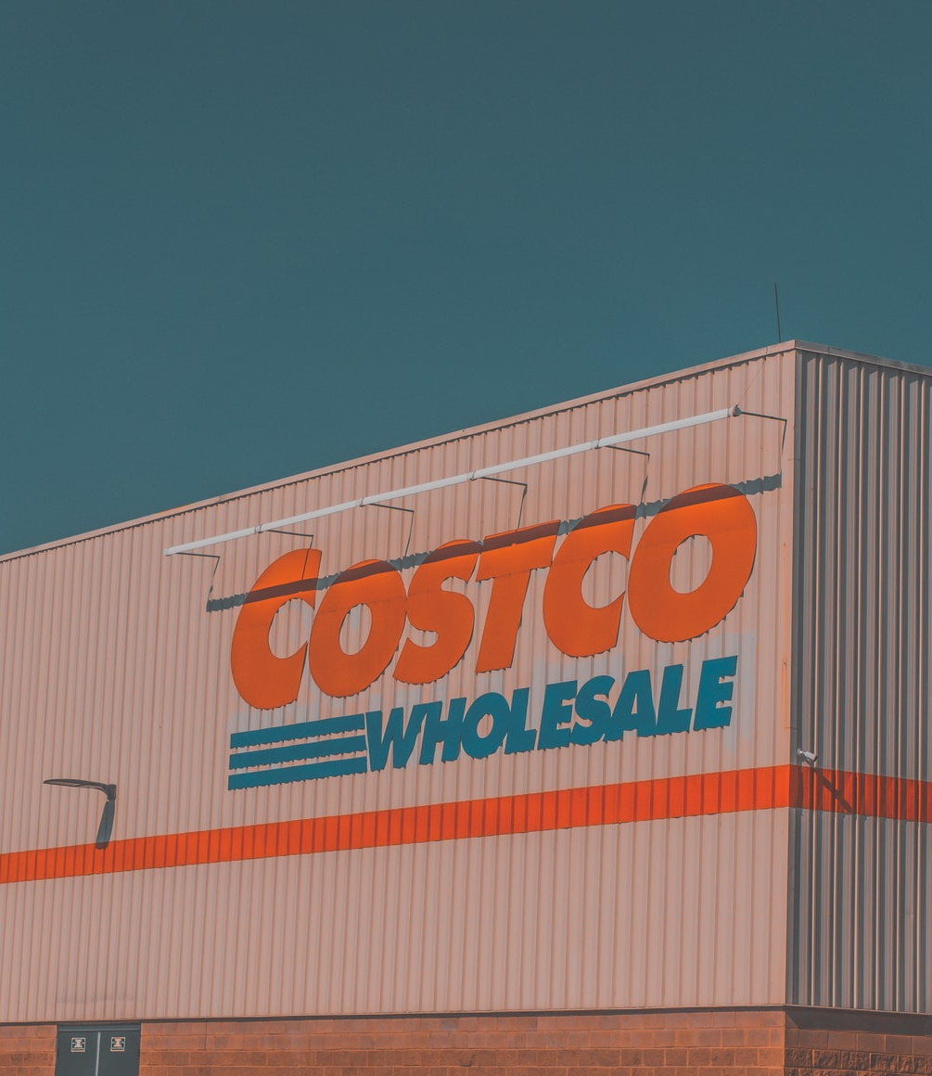
Into the work-from-home market
Helping Costco stay up-to-date with the evolving customer demographics
Josh Wang
3/23/2022
Image: unsplash

Slide 2
The background: Costco customers are exceedingly loyal
buy
Despite limited product selection compared to Walmart and Amazon, Costco manages to fulfill its customers’ needs.
In 2020, 91% of its customers renewed their membership.
(The Motley Fool)

Slide 3
The problem: customer Demographics are evolving
69% of U.S. employees worked remotely at the peak of the pandemic
82% of U.S. employees want to work remotely at least once a week when the pandemic is over.
82%
(Global Workplace Analytics)

Slide 4

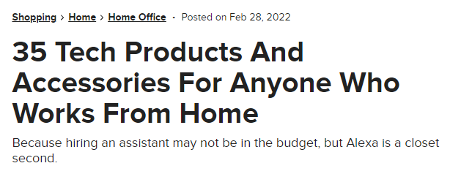
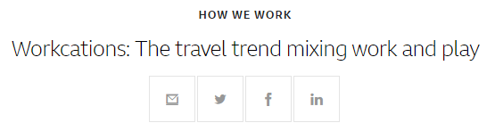

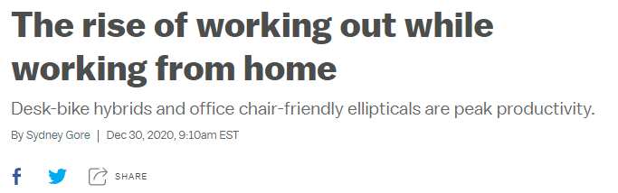

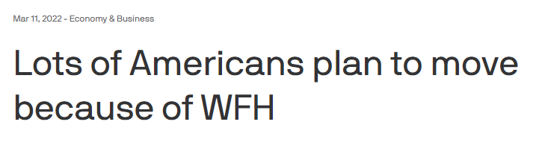
Opportunities
Costco Vision care
Costco Travel
New product demands
Any many more…
New store/depot locations, change in shipping logistics

Slide 5
We need to keep costco up-to-date
With our service, Costco can…
Identify regions and demographics with high WFH tendency
Have more tailored catalogs at each warehouse
Better customer retainment and overall improved sales

Slide 6
Proposed solution path
01
Identify WFH trends in the US
03
The data
EDA
Future modeling
Telework data from US Census
Google Mobility Data
Costco Warehouse Data
02
Clustering – new warehouse locations
Association – refreshed catalogs
Time series – predict WFH trends

Slide 7
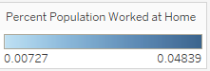
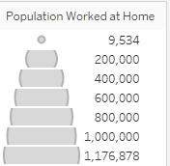
Preliminary analysis – WFH Trend pre-pandemic
The WFH trend has been growing since before the pandemic (2004-2019)
Data source: Google Mobility

Slide 8
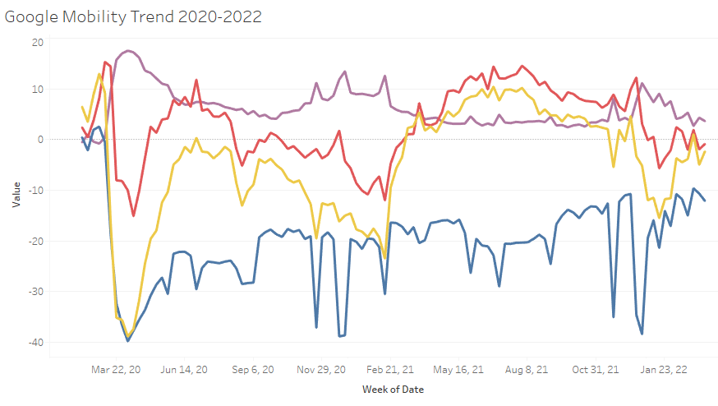
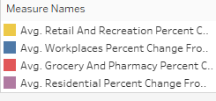
Preliminary analysis – wfh trend during pandemic
During the pandemic, people go to work less, stay at home more, but grocery/retail shopping see little change.
Data source: Google Mobility

Slide 9
Preliminary analysis – wfh age demographic
The majority of WFH population are above the age of 40.
Data source: Google Mobility and Census.gov

Slide 10
Preliminary analysis – wfh income demographic
The majority of WFH population make more than 100k per year.
Data source: Google Mobility and Census.gov

Slide 11
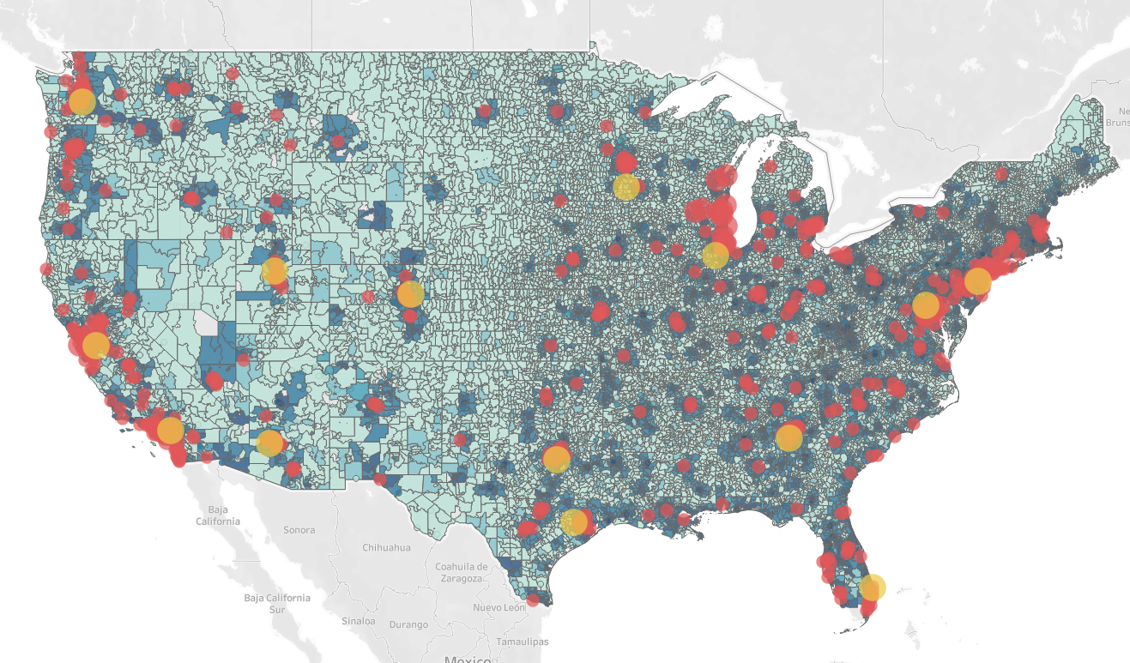
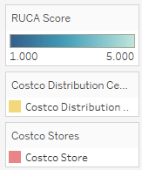
Preliminary analysis – costco location
Potential in the suburban market
50%
50% of urban WFH workers would move to a suburban/rural area
(Owl Labs Survey)
Data source: Costco and Census.gov

Slide 12
Future works
Predictive models:
Time series to predict future WFH trends
Identify geographical regions for new Costco depots/stores
Association and recommender analyses to improve on-site and online shopping experience

Slide 14
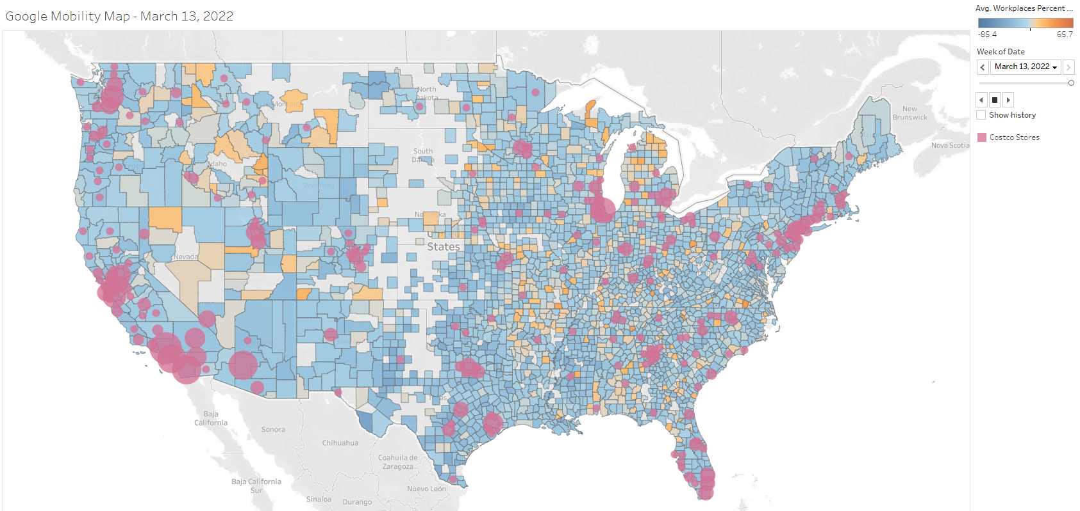
Appendix – Costco locations vs google mobility
Data source: Apple Mobility and Costco

Slide 15
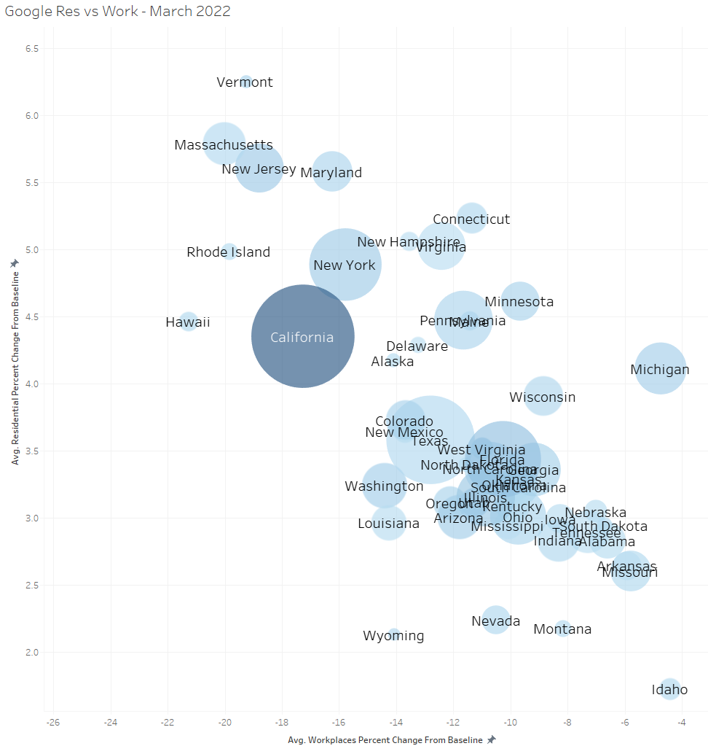
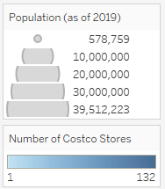
Appendix – Costco locations vs google mobility
Data source: Google Mobility and Costco

Slide 16
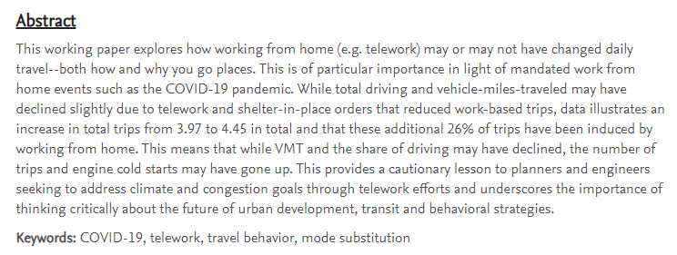
Appendix
Notes:
https://papers.ssrn.com/sol3/papers.cfm?abstract_id=3638885

